Slide 1
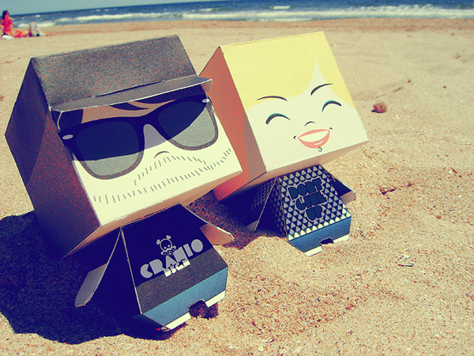
Building the Foundation
Activity selection, assessment, diagnostics
NMRC May 24, 2012

Slide 2
I have never let my schooling interfere with my education
-Mark Twain

Slide 3
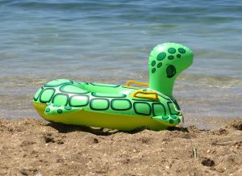
Sources for Activities
Books
Websites
  Youtube
Prior experience
“Inspired” Groups
Etc.

Slide 4
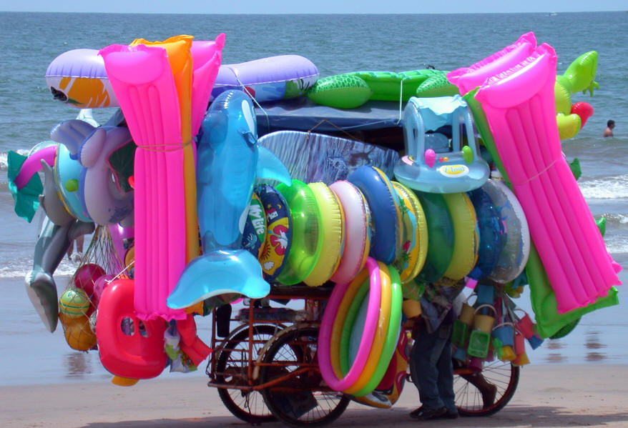
However……
All groups are different
  Examples
The role of forces beyond your control
  Examples
Leader/facilitator ‘buy in’
  Examples

Slide 5
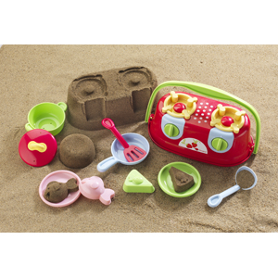
“Sheryl’s 3 step process”
Does it make sense to me?
  Do I understand the rules and structure of the activity? (Can I visualize it?)
  Is there identifiable ‘purposefulness?’
    Including just ‘have fun’
  If “No,” keep looking, or…
    …try it out

Slide 6
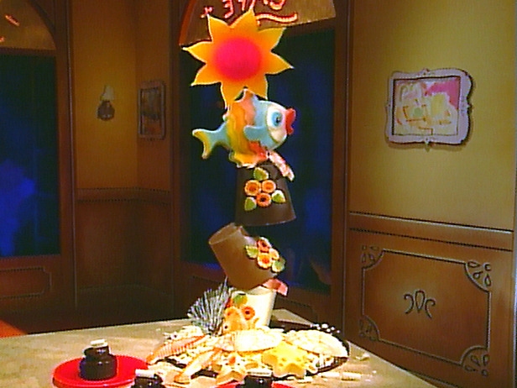
“3 step process” cont’d
2. Would I engage in this activity (or play this game?)
  If “No,” then keep looking
General rule of (my) thumb: Do not ask participants to do things I would not do
  Exceptions

Slide 7
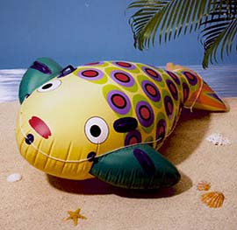
“3 step process” cont’d
3. Can it be modified before AND during?
  How will changes to a ‘known’ activity be received?
  How will changes made during be received?
    Plan ahead

Slide 8
More parts of the process
Group/participants characteristics
Available setting(s)
  Weather
# of participants
# of staff/helpers
Supplies
ME!

Slide 9
Learning to appreciate competition
Within
Between
Improve on own performance
Improve on group performance
Intrinsic OR extrinsic rewards/motivations
Encourage “task” orientation
Reduces role of ‘failure’
May bring out the best performance
Adds some excitement
IMPORTANT: it does not REALLY matter
De-emphasize the ‘you lose’ part
  Keep moving; go on to the next thing
  Do not necessarily tie to rewards
  Shuffle teams

Slide 10
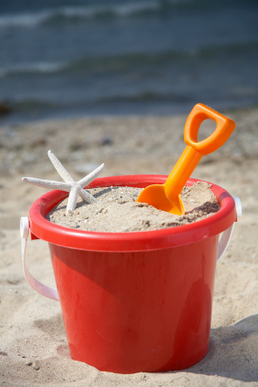
Competition cont’d
Points, rounds, games may be lost, but participants are not “losers”
Emphasize mutual respect and empathy
De-emphasize vicarious success
  Leads to perceived expectations,
  Pressure, anxiety
  Cheating
Use of symbolic ‘closure’ activities (more in session 6)

Slide 11
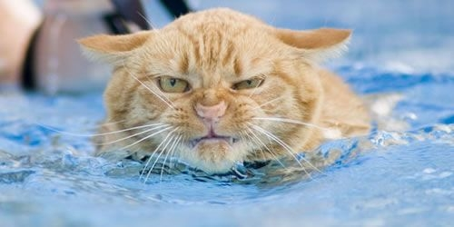
When things go wrong….
Stop
  Confusion, ambiguity, insecurity
Revise
  Simplify, slow down
Move on
  Ongoing problems may suggest participant issues
Try again
  Different group/setting

Slide 12

Activities
Demo
Instant Impulse
Rubber Chicken Relay
Kung Fu Baseball

