Slide 1
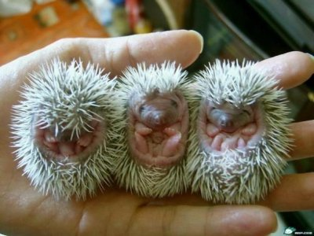
Creating the Framework:
Specific Activities and Adaptations
NMRC May 24, 2012

Slide 2
No one is useless in this world who lightens the burden of it for anyone else
-Charles Dickens

Slide 3
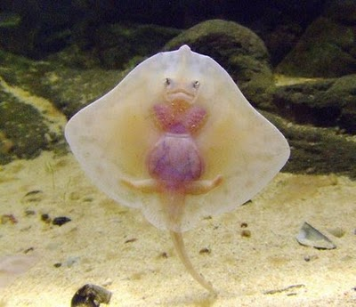
Activities
Goal Ball demos
Silent Mating Game
Cowbell Dragon Tail

Slide 4
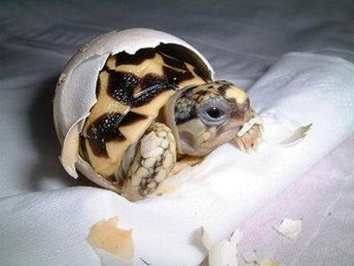
Blind or visual impairment
Range from partial to complete inability to distinguish dark/light
  Corrective devices
  Other aids
Psychosocial aspects
  Range from none/minimal to varying degrees of dependence, insecurity

Slide 5
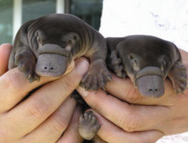
Accommodations
Verbal prompts, directions, descriptions
Opportunity to touch; simulations
Bright colors/high contrast
Sound/vibration
  Bells – nets/goals, pins, etc.
  “Whistling” balls
  Rattling objects
Ball “harness”
  Volleyball
  Soccer

Slide 6
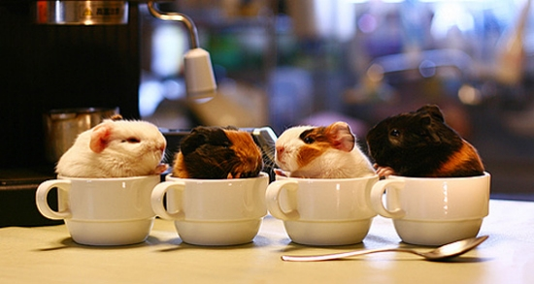
Goalball
Paralympic Sport
ALL players wear eyeshades
Tape/rope for lines
See website for official rules
Provide assisting player with contact cues for hearing impairment
Multiple variations using same equipment

Slide 7
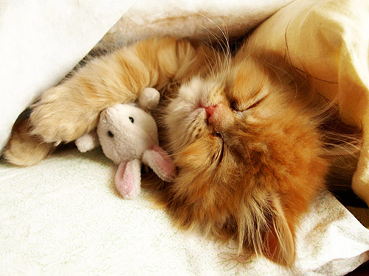
“Sculpture”
(Low to moderate activity)
1 or more person pose
Re-create with one or more persons located proximate or further away
  Accuracy OR accuracy and time
  Within or between competition

Slide 8
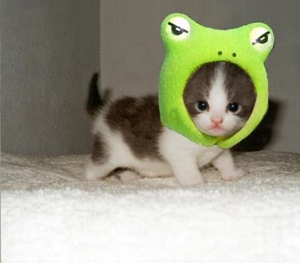
Two more
Beach Volleyball
Indoor Hockey
Net
Beachball
  Insert uncooked rice
Prepare multiple balls for “Dodgeball”
Attach bells to flying disc with string
Tape/rope for lines
Hang bells from goal netting

Slide 9
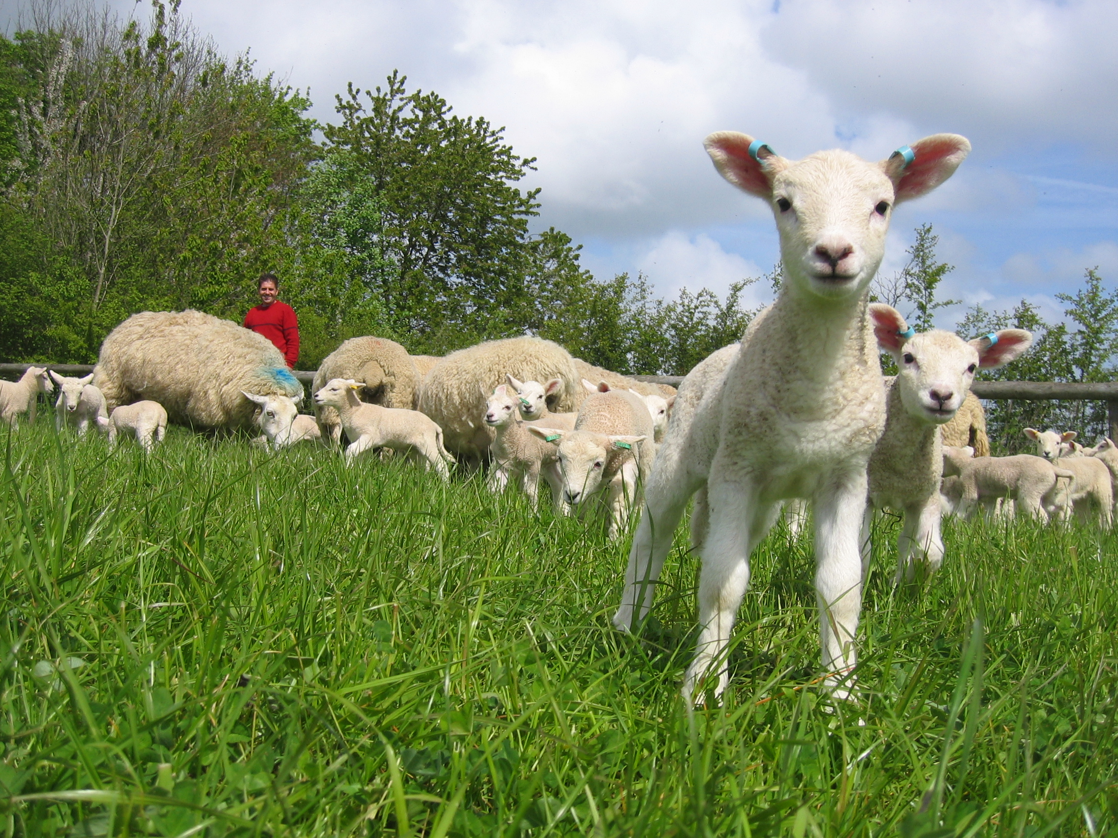
Deaf or hearing impairment
Partial to total
  Corrective devices
  Challenges with changes in hearing
Psychosocial Aspects
  Range from non/minimal to varying degrees of depression, isolation, denial

Slide 10
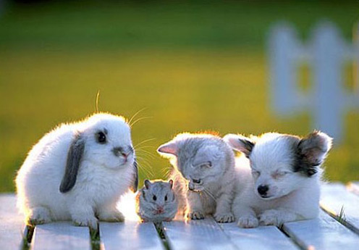
Accommodations
ASL
Written directions/prompts
Lip reading
Facial expressions
Agreed-upon signals
  Stop, move, etc.

Slide 11
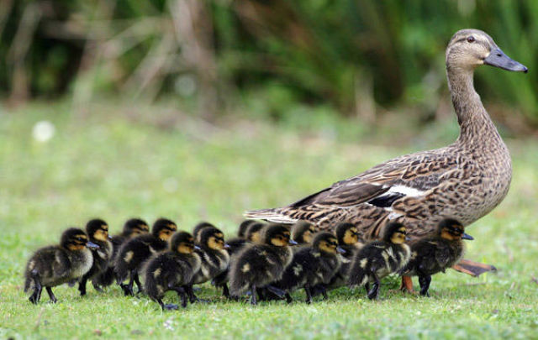
Activities
“Super” Moonball
Variations on Sports
One large ball, maximum hits before striking the ground
  “Everyone hits” rules apply as desired
All participants have rope or bungee
Tie (a specific) knot between hits
Ball striking ground (or rope) = start over
Count max number of hits after all ropes are knotted
Group plays for the ‘record’
Inclusive teams, if possible
  Improves social skills, provides opportunities for normalizing
Baseball/softball
  No chatter rule (visual distractions?)
  Ropes and cones for visual impairment
Flag or touch Football
  Visual signal for end of play

Slide 12
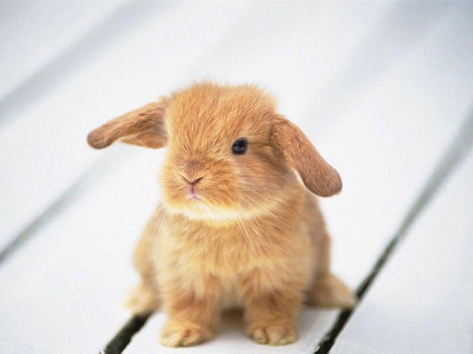
Multiple Disabilities
Persons with more than one disability
Mixed groups
Mixed abilities
Different rules for different participants
Helpers
Ask!!

Slide 13
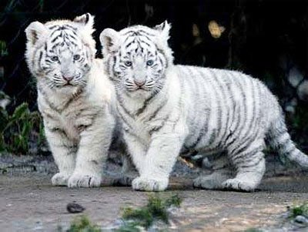
“Tactile Twister”
  Create textured Twister surface from sheet
  Glue (or sew) fabrics, trims, outlines
    Upholstery fabric, textured fabrics, carpets, other surfaces
  Create spinner with surface, Braille for body part, outline or other symbolic representation

Slide 14
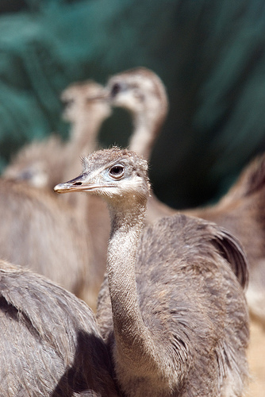
SOCKLEY (a lead up game)
Punch ball balloon(with uncooked rice inside)
2 Poles – one line running between
  Volleyball net ends
Loop/o-ring/pulley that moves freely along line
Attach punch ball to pulley. Line participants up on either side of the line. Object is to hit the ball toward the other team. Raise/lower ball as desired, lengthen/shorten course. Hang flags or fabric behind participants to keep score count.

Slide 15
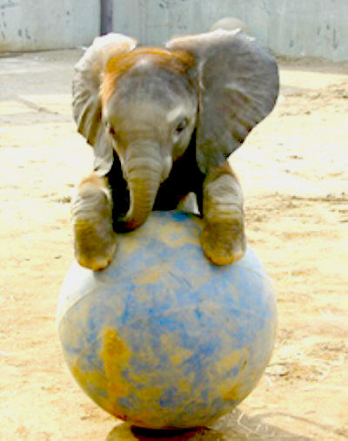
Be creative with scavenger hunts
Good for large groups and long periods of time
Labor intensive to set up
Appropriate for inclusive/different levels of ability
Collect sights…….sounds…….touch….smells
Use iphone to photo or record
Using ‘living’ clues (people)

