Slide 1

Warm and Fuzzy:
Experiences and expressions in sensory stimulation
NMRC May 24, 2012

Slide 2
Nothing is impossible, some things are just less likely than others.
-Jonathan Winters

Slide 3

Sensory Stimulation
Relieves stress
  Focus on external stimuli
  Sensory ‘memories’ replace other cognitions
Improve brain functioning (synaptic connections, neuron transmission)
  Alleviate depression, isolation

Slide 4
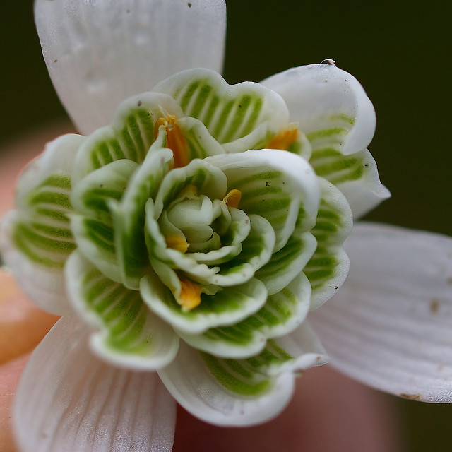
When is this bad?
Negative reminders/memories
  Difficult to predict
Overload
  Too much to process
  Disconcerting or frightening rather than calming
Use care for Individuals with Autism

Slide 5

Creative Expression and Efficacy
Self-efficacy results from:
  Obtaining desired result from an action or activity
Creative expression activities facilitate subjectively defined success
Visual, lasting products may result in ongoing reinforcement
Success inspires further attempts

Slide 6

The “Ducteridoo”
http://www.youtube.com/watch?v=DC9w4KWEgJE
Directions for “Ducteridoo,” and PVC and beeswax “Didgeridoo” on presentation website
Recreationworkshop.weebly.com

Slide 7

Ducteridoo
(Instructables.com)
PVC Pipe
Oil
Duct tape
Hacksaw (maybe)

Slide 8

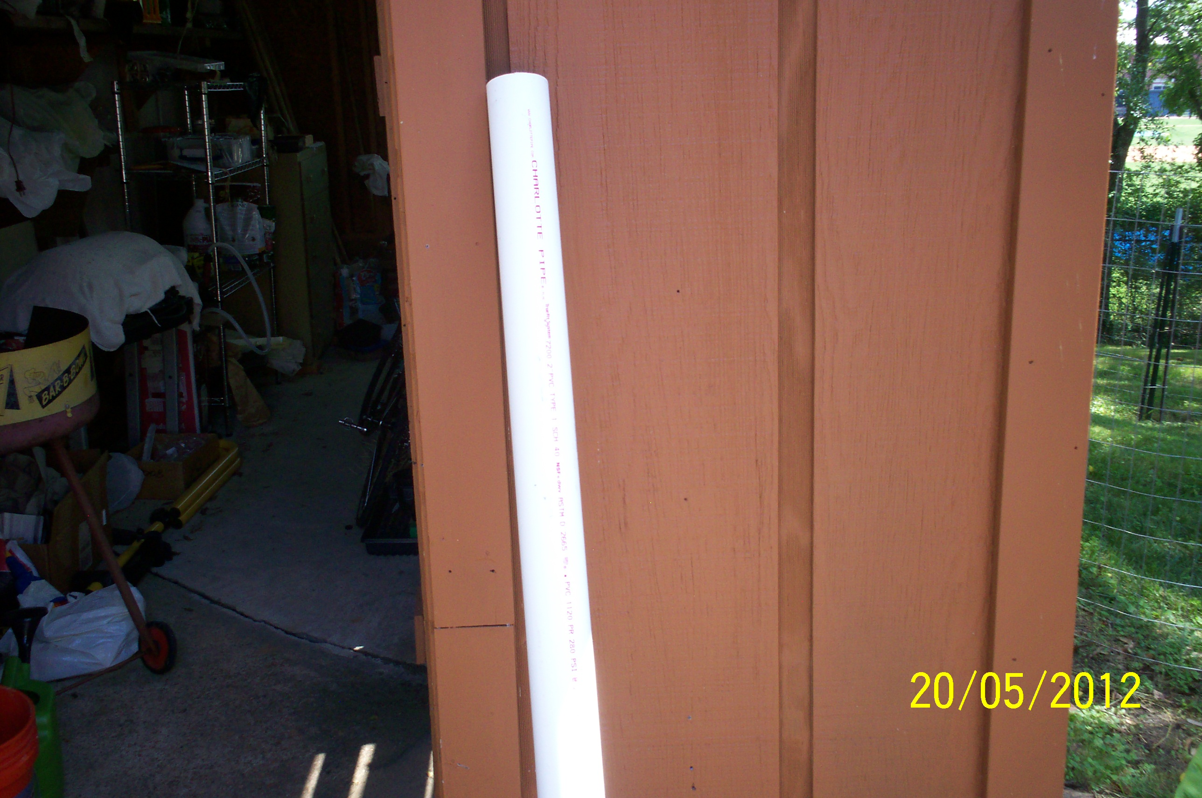
Steps 1 and 2
Size and oil the PVC pipe
  10 ft lengths at HD
  2 x 5
  4 ft
  Olive oil w/ rag

Slide 9

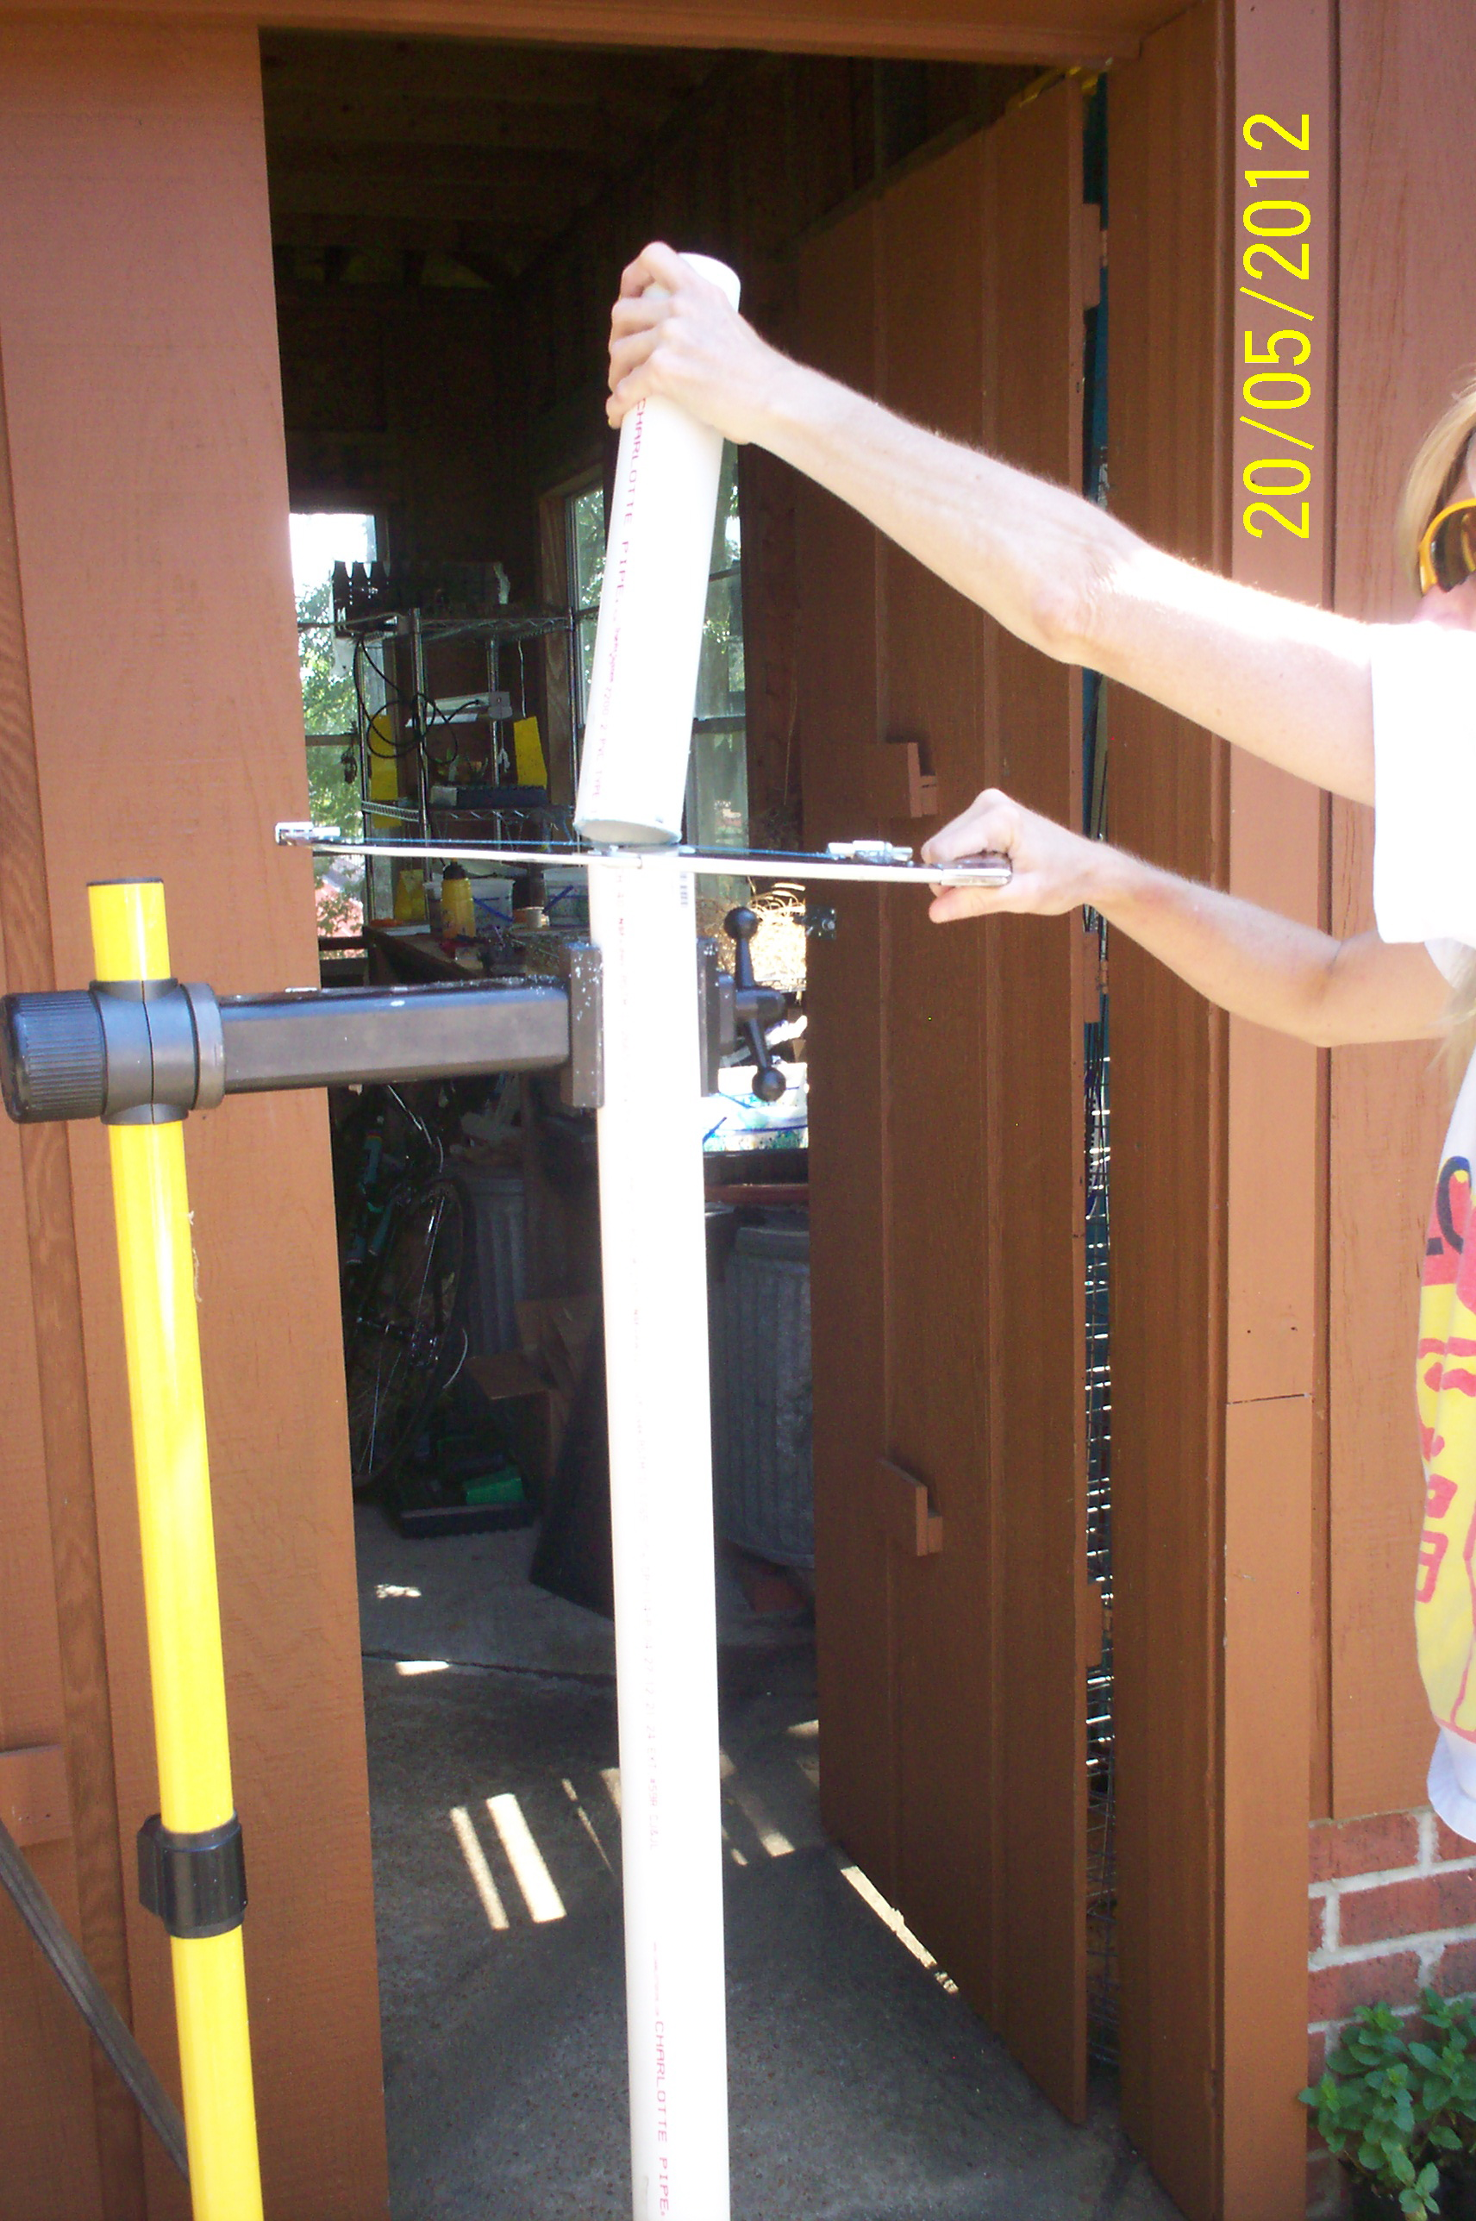
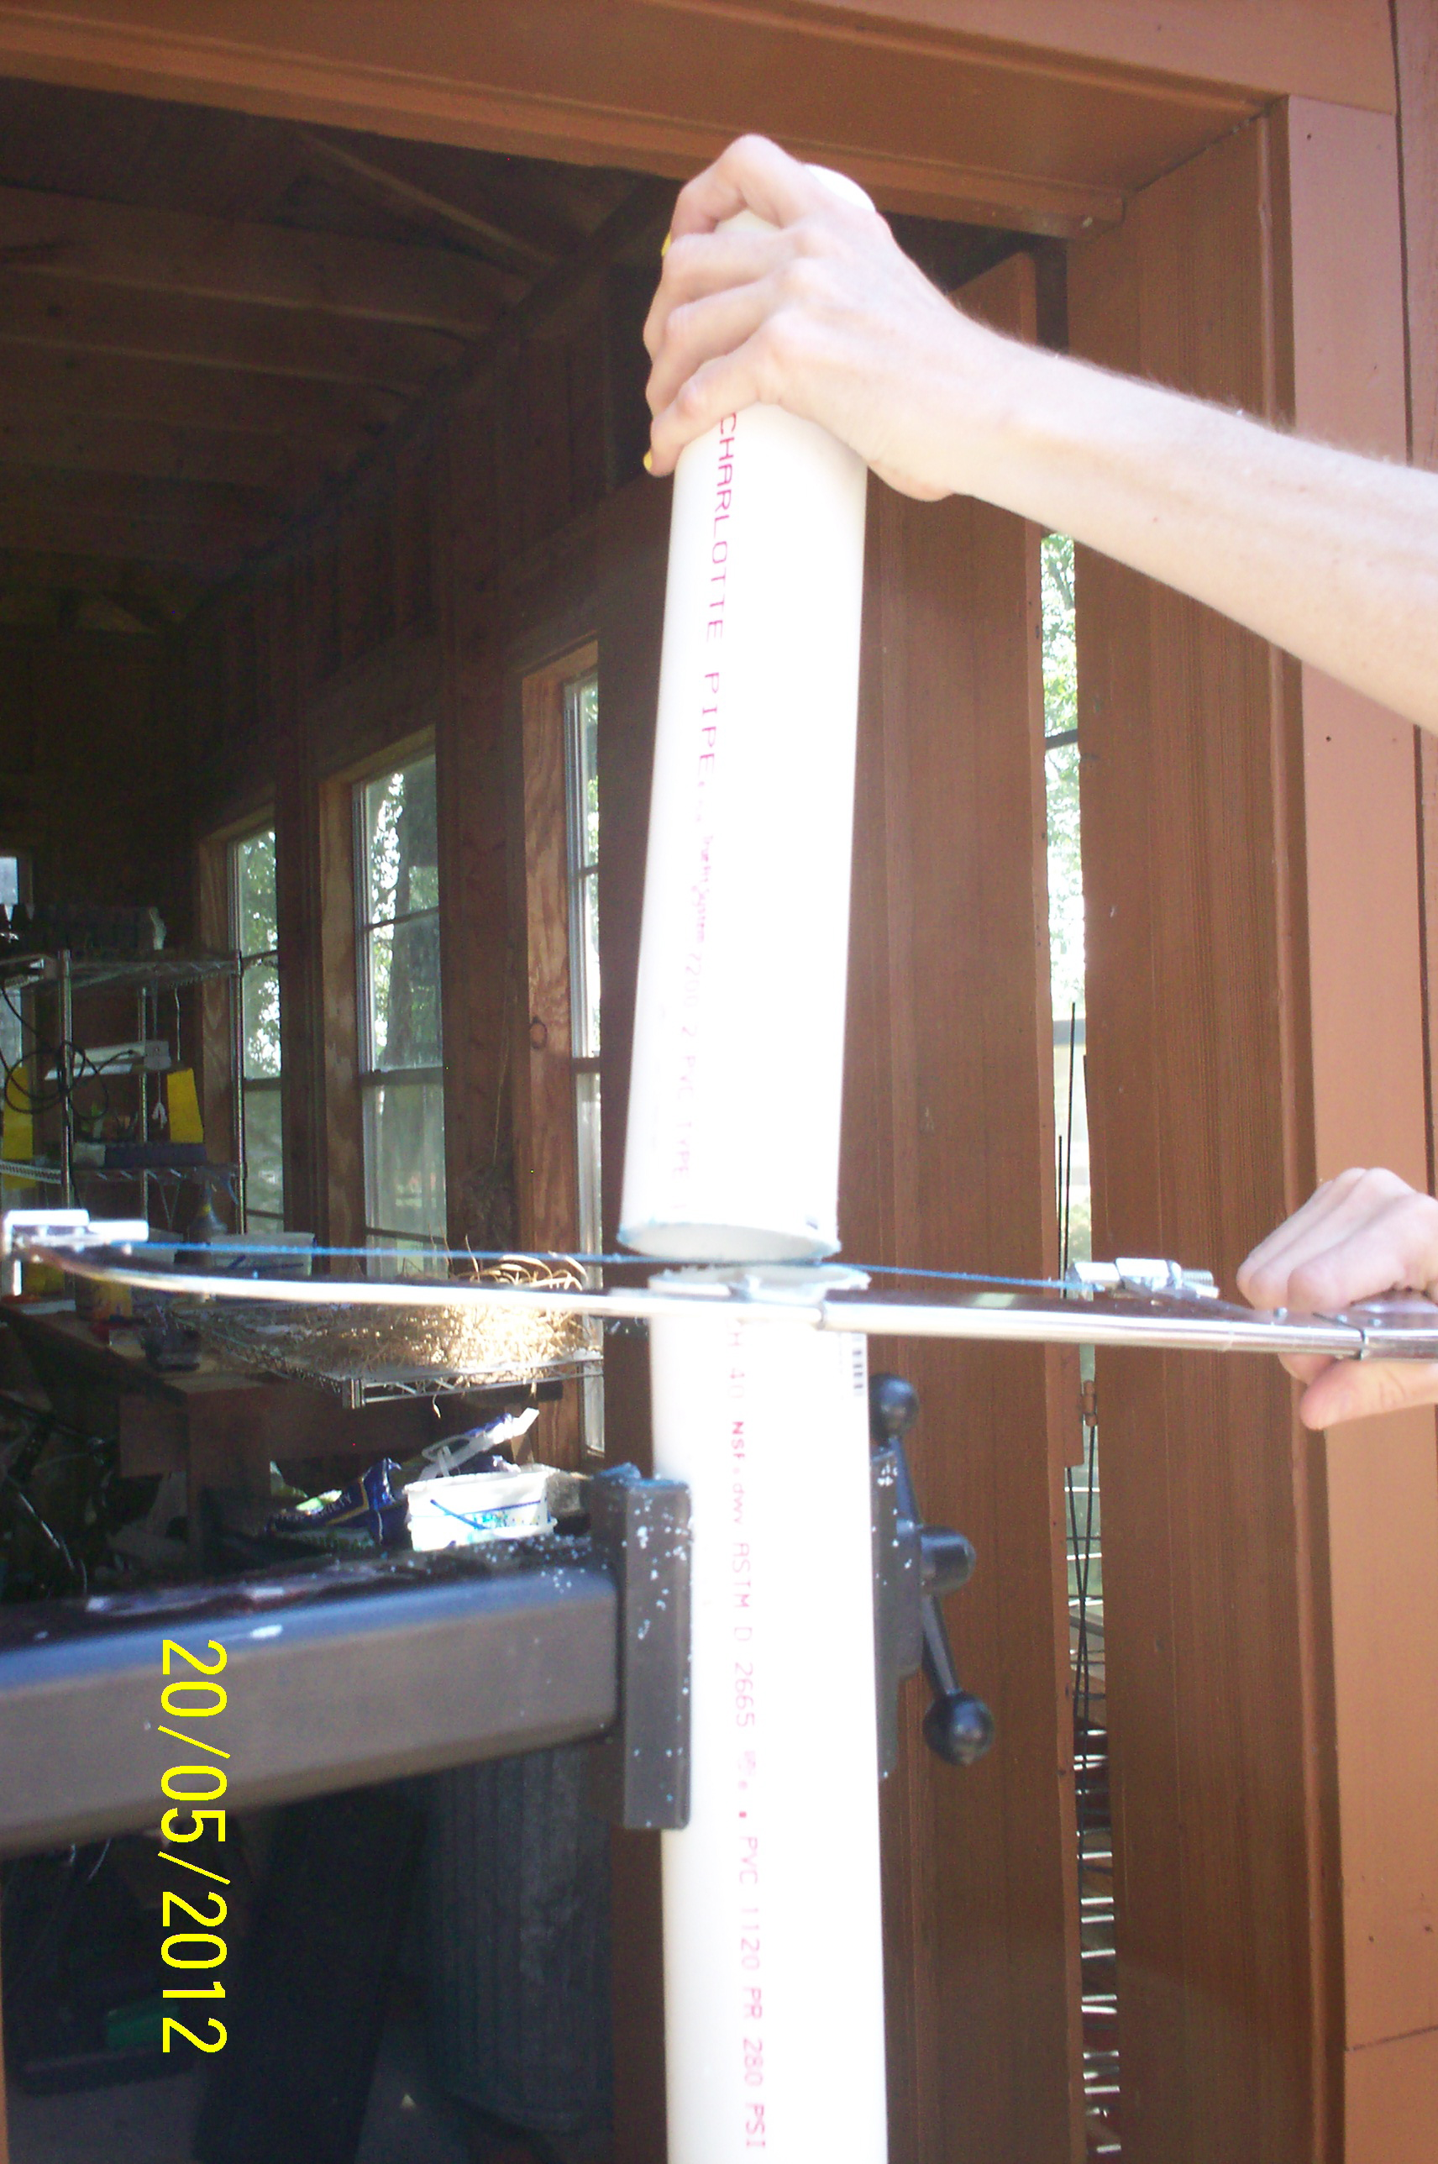
Bicycle repair stands are nice!

Slide 10
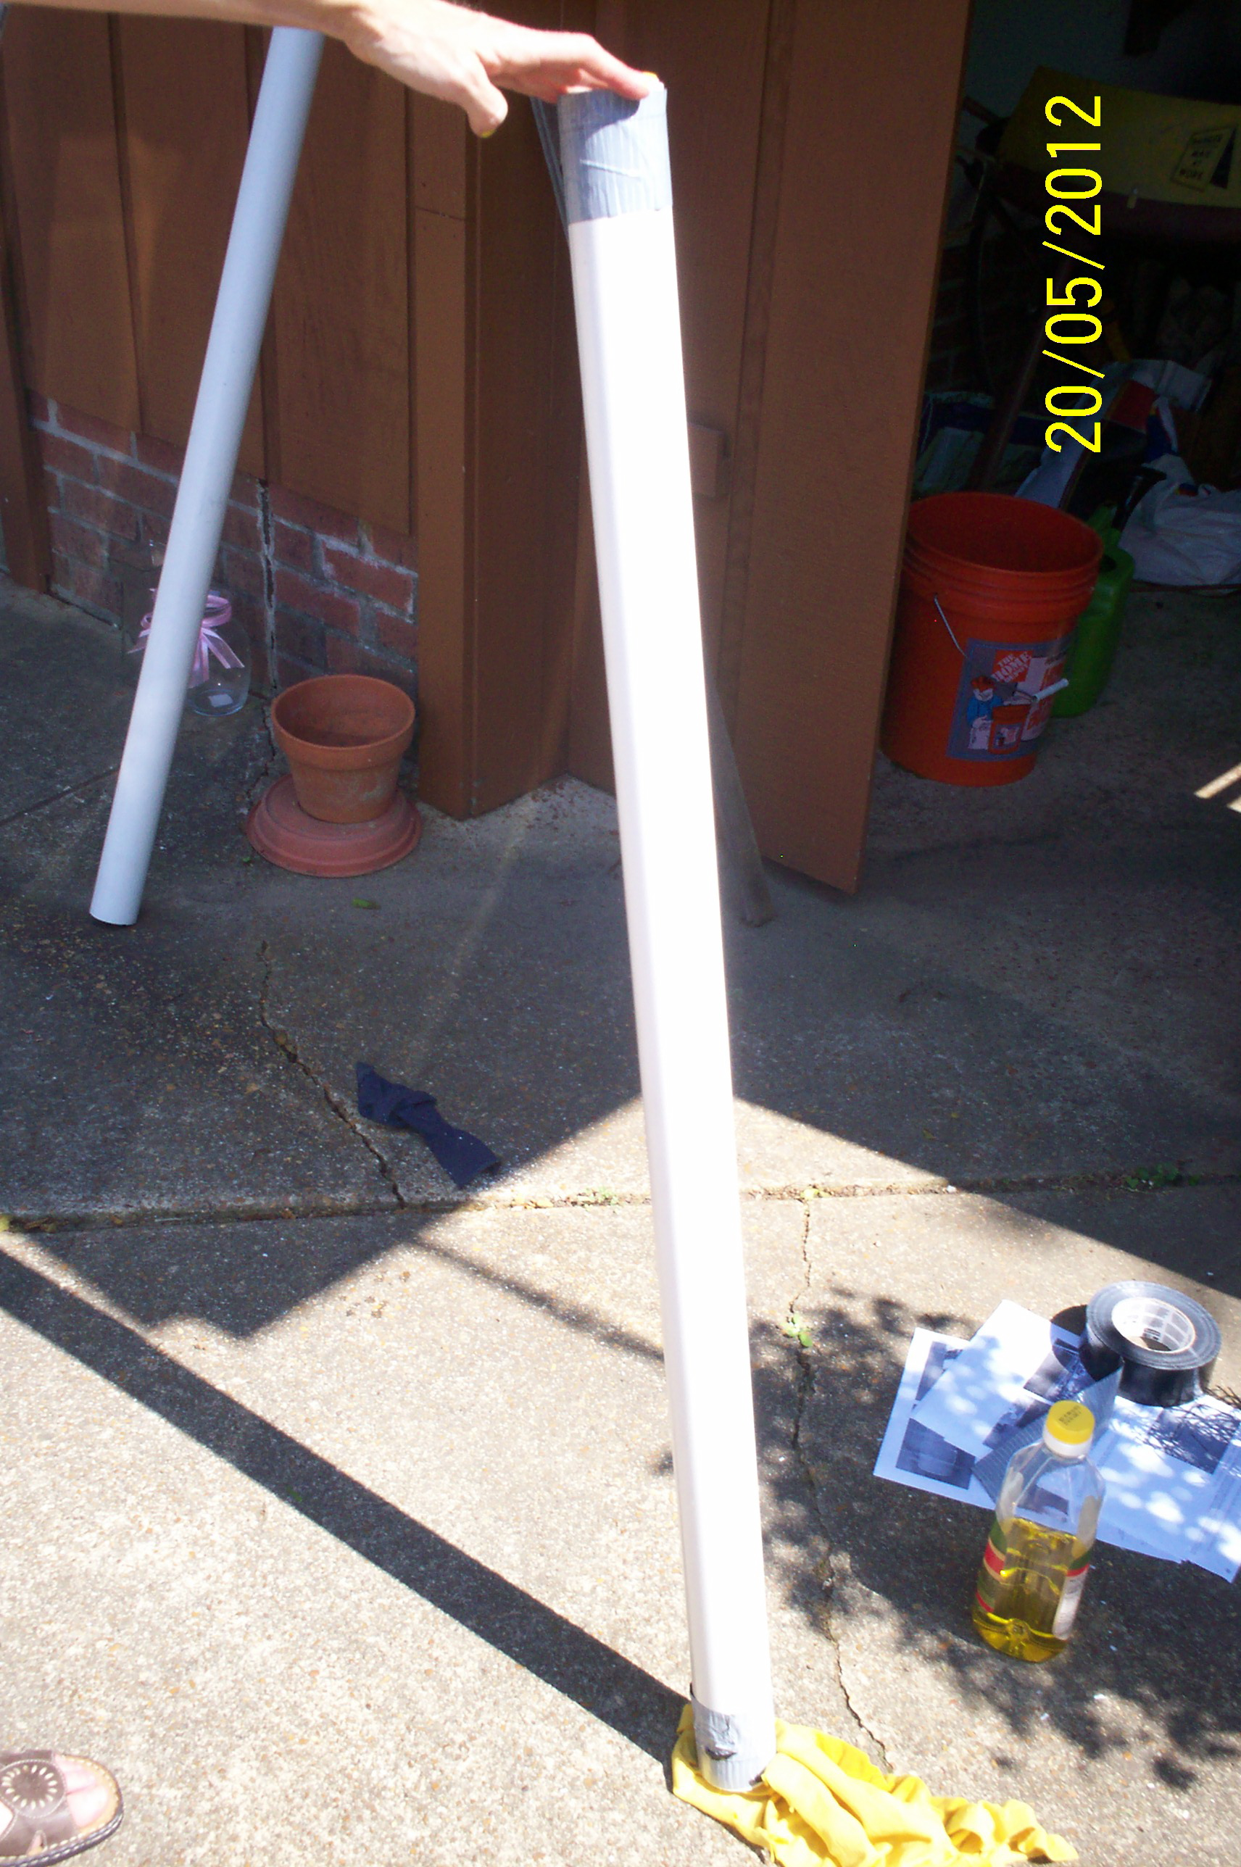
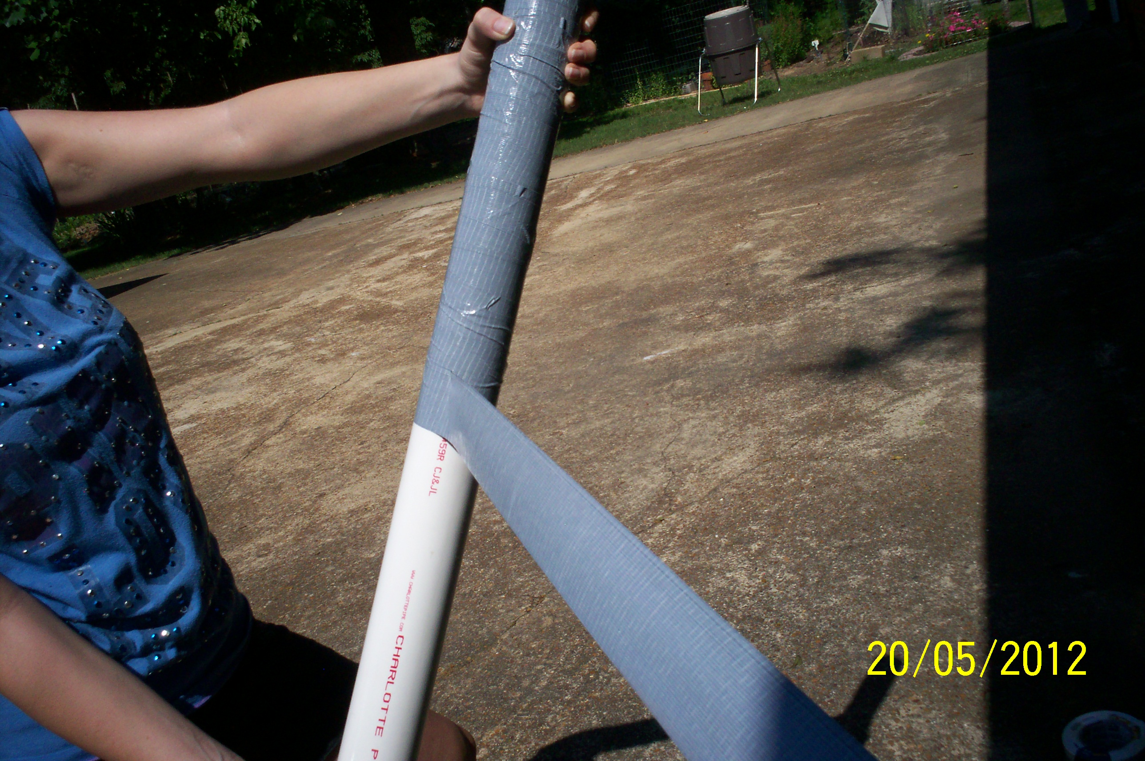
Step 3- Wrap tape (first layer = sticky side out)

Slide 11
Wrapping
First layer:
  Thicker at top/bottom
  STICKY SIDE OUT
Second and additional:
  Sticky side IN
  Thicker at top/mouthpiece

Slide 12
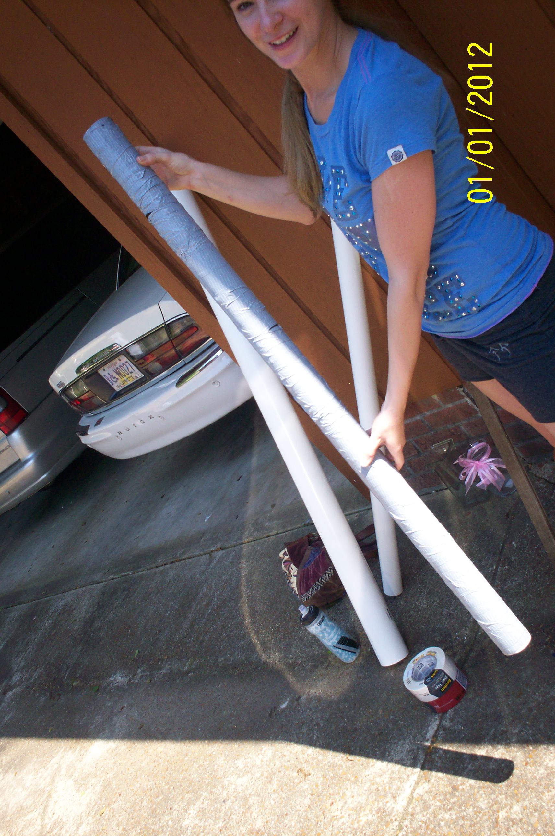
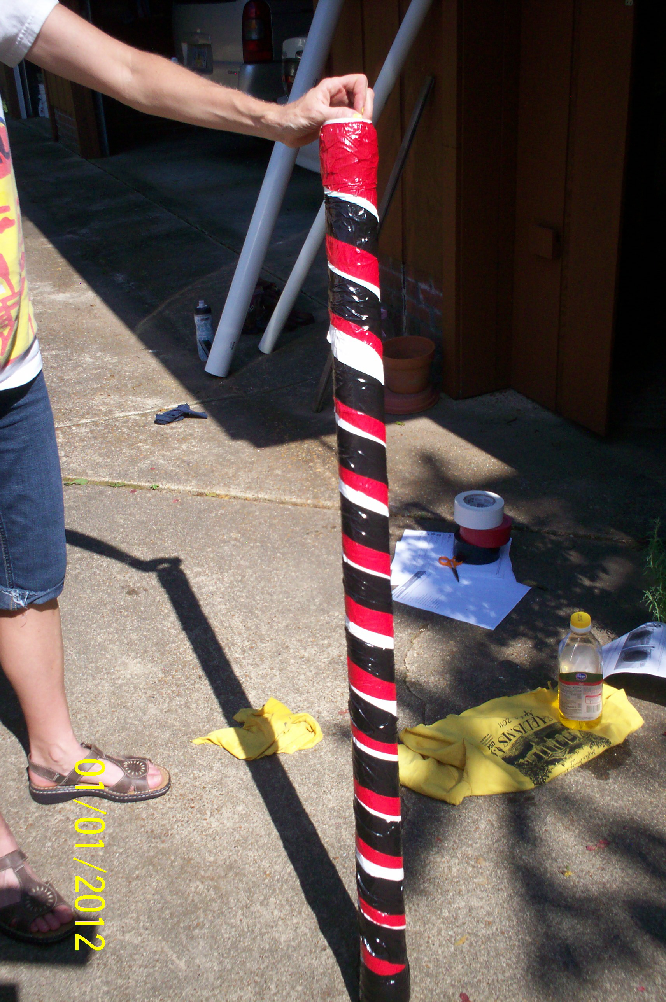
Wrapped Up!

Slide 13
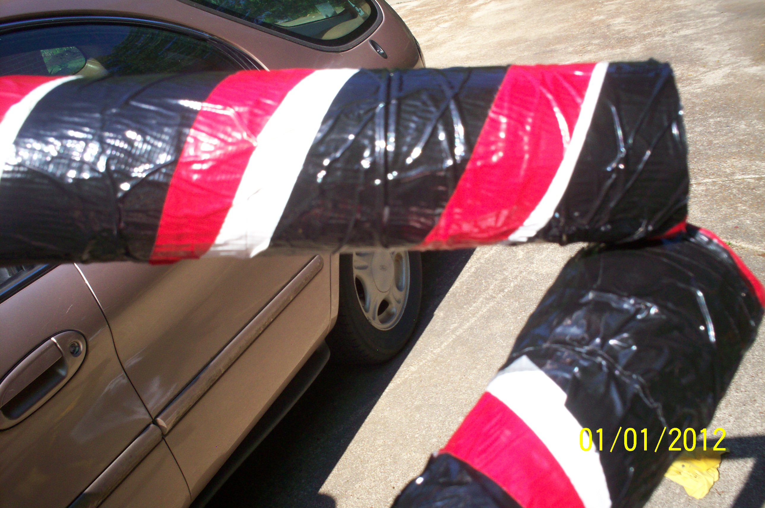
Step 4 (the hard part)
Shake, shove or otherwise slide the duct tape off the PVC pipe
DEMONSTRATION
Backup plan

Slide 14
Finishing
Build up ‘mouthpiece’ with layers of tape
PLAY!
Practice, practice some more
Try again

Slide 15
To try
Planting
Pressing
Vining
Scenting
Try these with eyes closed!!!

