Slide 1
Finishing touches:
Flow, motivation, and debriefing

Slide 2
A child of five could understand this. Send someone to fetch a child of five. -Groucho Marx

Slide 3
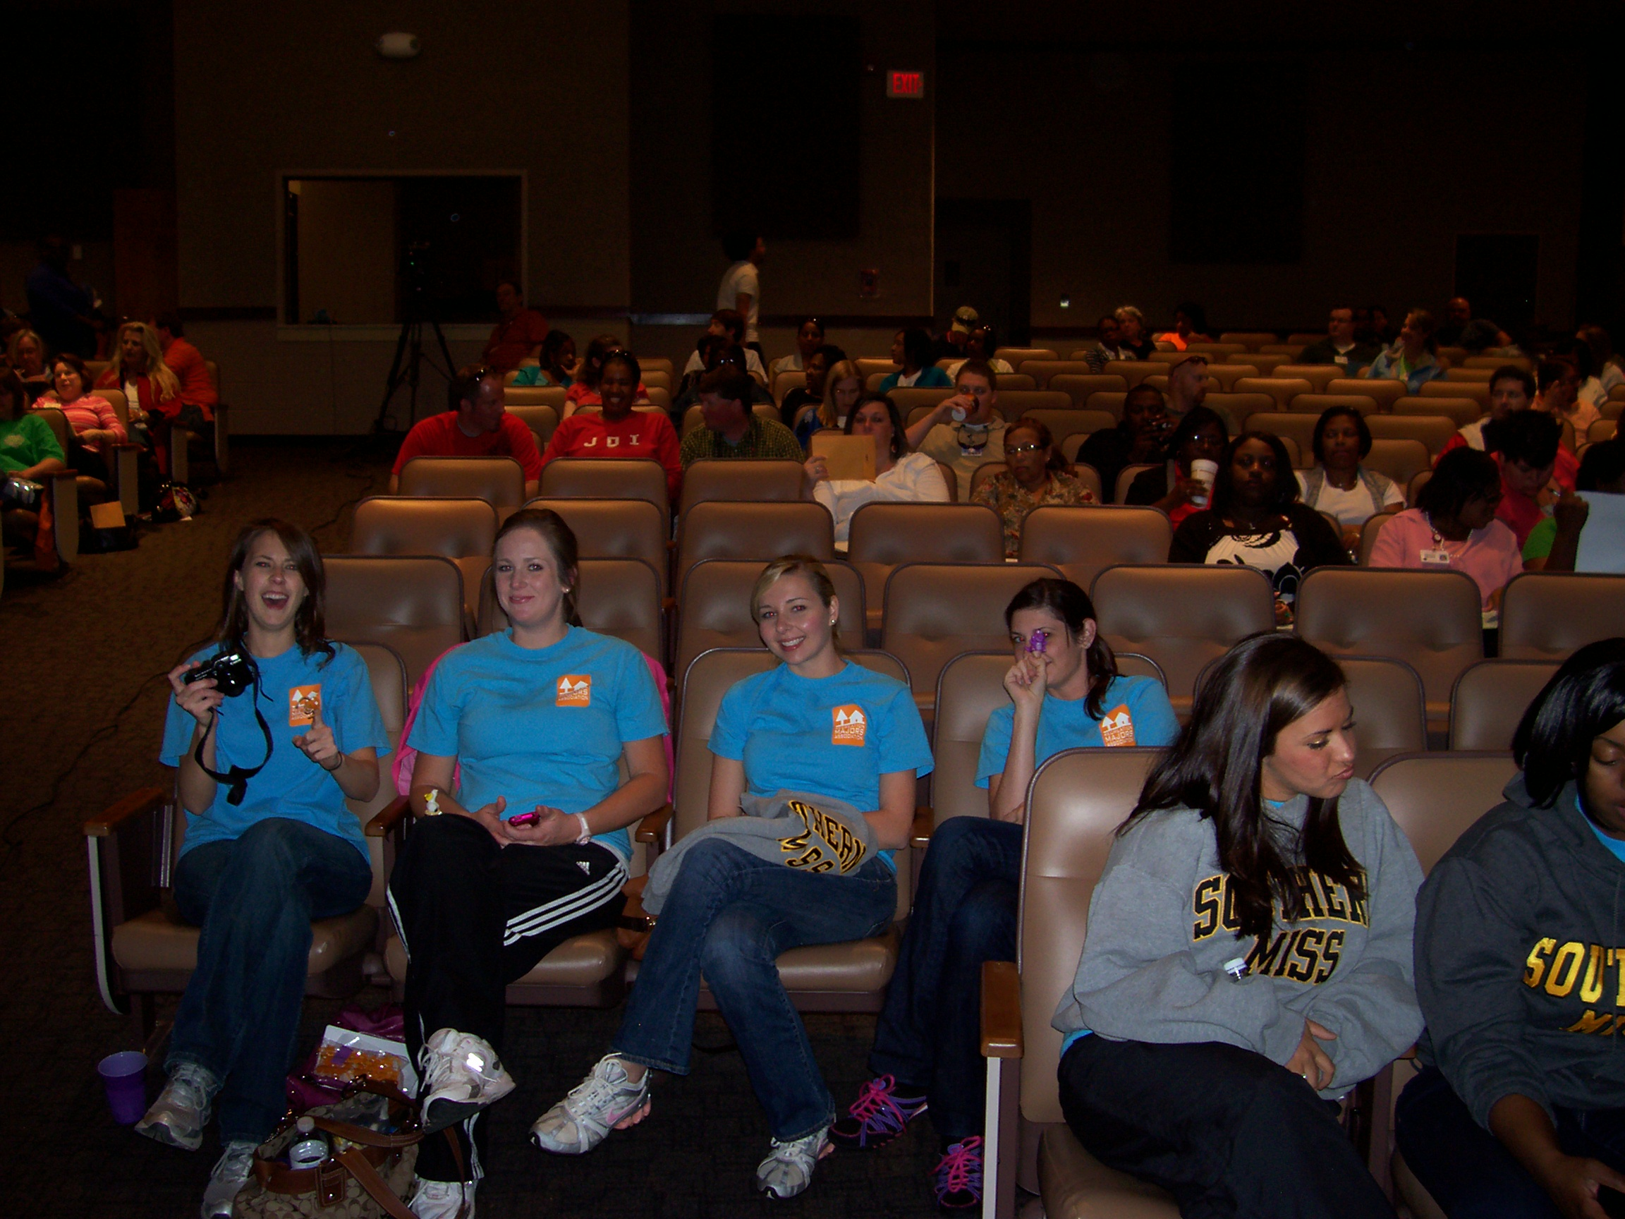

Slide 4
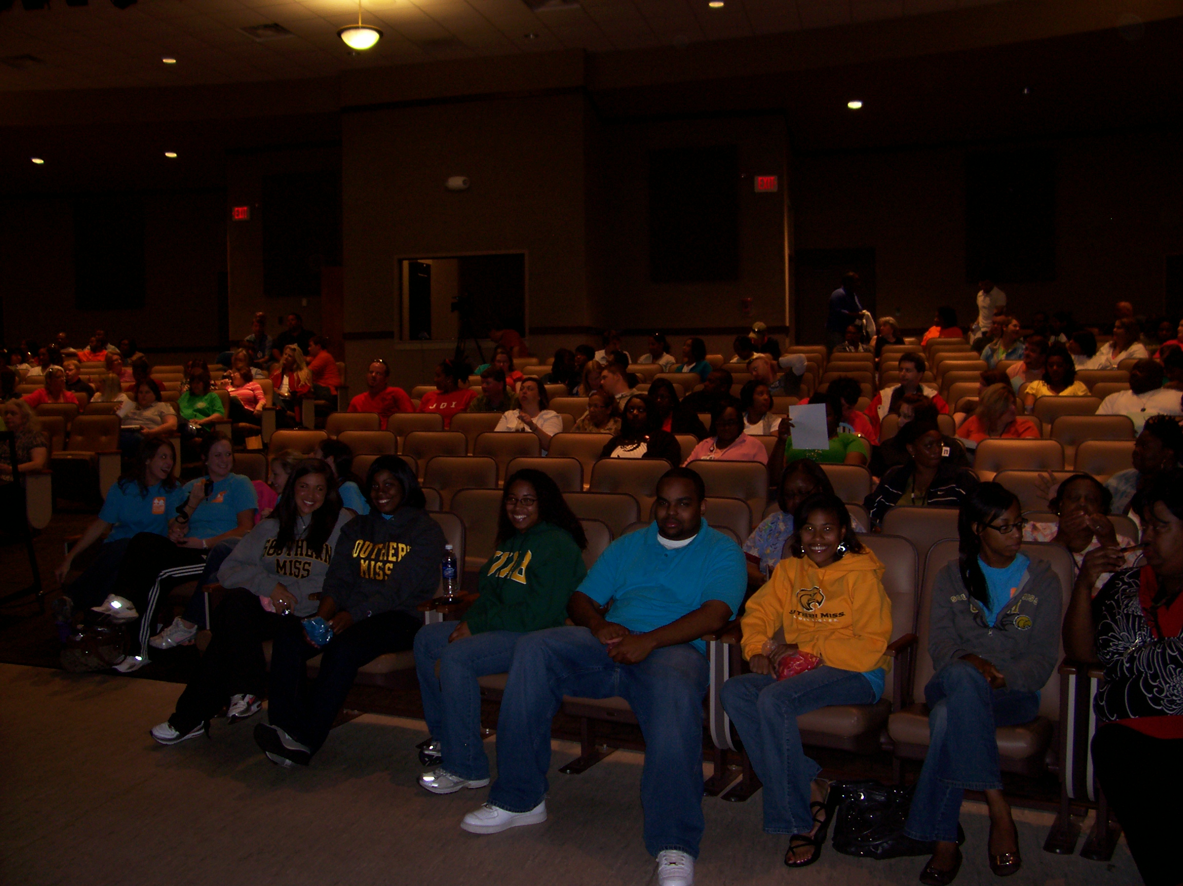

Slide 5
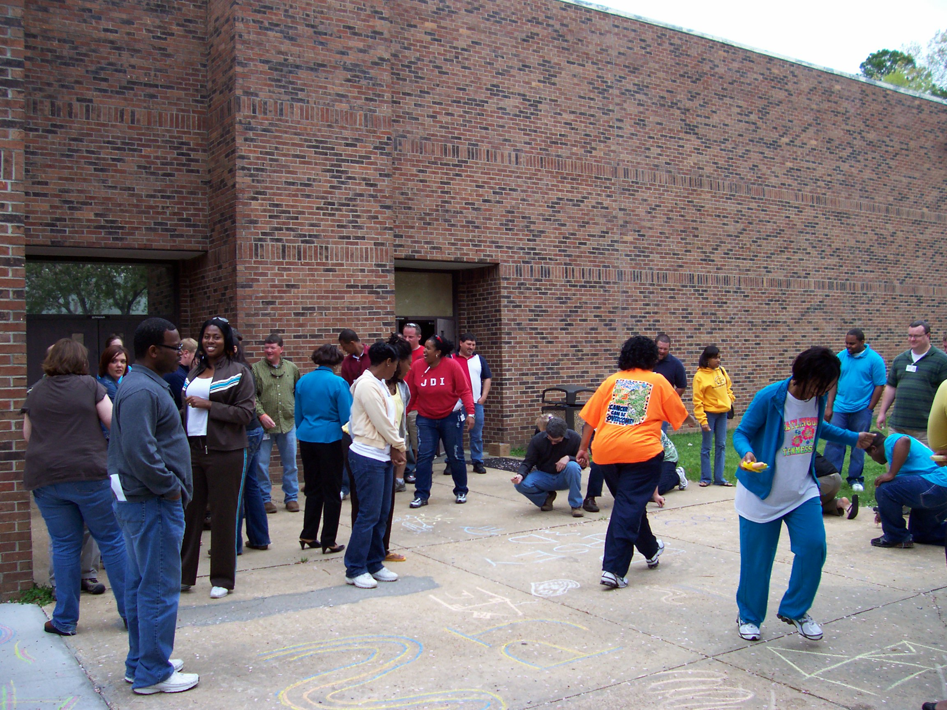

Slide 6
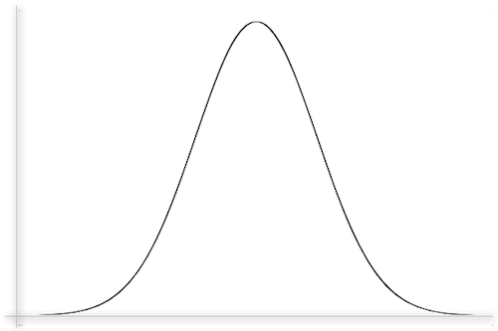
Remember this?
“OPTIMAL AROUSAL”
Reaction
Level of Perceived Challenge

Slide 7
From Optimal Arousal to Optimal Experience (“Flow”)
Happiness depends not on events, but on how we as individuals interpret events
Is rarely found through searching
Associated with ‘control over consciousness’
The best experiences often are those that allow individuals to forget the ‘small stuff’
Can you remember feeling this way?

Slide 8
FOCUS
Mono tasking
Concentrating on the current action, not events from before or yet to occur
Loss of sense of time
“Minute Measure”
1,2,3

Slide 9
More on Flow
Rock climbers and brain surgeons (and factory workers)
“If only” sometimes leads to “I miss the ways things used to be” (not always
Compromise between practical and ideal
Striving toward ideal
Enjoying the activities you commit to (“If it is worth doing, it is worth doing well”)

Slide 10
Motivation
Subject of much research, analysis
Need for competence, autonomy , relatedness( Deci and Ryan)
Seek reward, avoid punishment (Skinner)
Improve performance OR compare to others (Nicholls)
Complex set of behaviors learned to a great extent through observation (Bandura)

Slide 11
Why emphasize intrinsic (Internal)?
Extrinsic rewards lose value and meaning over time
Value may be subject to others’ interpretation
Ever increasing extrinsic rewards are unrealistic if not impossible
Subjective quality of intrinsic achievement
Allows for changes over time and due to circumstances
Allows for changes in values, interests

Slide 12
Why emphasize intrinsic?
Can be long term or perpetual due to flexibility
Allows multiple ways to succeed and multiple successes
Not to be confused with the ‘everyone is a winner’ policies (which often use ‘extrinsic’ motivators)
Helps foster individual goal setting and re-setting

Slide 13
Debriefing
“Processing”
“Experiential learning cycle”
“Reflective learning”
Purposeful
Directed
Safe environment
Belief that experiences are more meaningful (and more educational)
Relive, analyze, project
What? So what? Now what?
Often accompany initiatives
“Teachable moments”

Slide 14
Debriefing
In active recreation
Contraindications
Identify discomfort and challenge
Common experiences
Benefit of other’s successes (or avoid less effective strategies)
Goal setting
Making people feel inadequate or inept
Creating competition when adherence or stability is the focus
Closing experience by emphasizing negative aspects
The essence of debriefing was accomplished during the activity

Slide 15
“Closure” Activities
May be especially important after competition
Shaking hands of other team, etc.
Rituals or symbolic actions
Touch everyone, then touch object
Reinforce positive
Purge anger or any hurt feelings
Leave on a ‘high note’ and with ‘groupiness’

Slide 16
Recreationworkshop.weebly.com

