Slide 1
A Symphony of Sights, A Rainbow of Sounds: Purposeful recreation targeting individuals with sensory impairments
May 24, 2012
North Mississippi Regional Center
Oxford, MS

Slide 2
Laying the Groundwork
The role of warm-ups, sequencing, and goals in physically active recreation

Slide 3
All material
Slides
Directions for games, activities
Directions for projects
List of sources,
Is available at…….
Recreationworkshop.weebly.com

Slide 4
The reason I talk to myself is that I’m the only one whose answers I accept.
George Carlin

Slide 5
“Sequencing” Activities
Social/cognitive/emotional
Do participants know each other?
Is it meaningful or feasible?
Time of day and normal schedule
Expectations and confidence
Plan “warm ups” for these domains

Slide 6
“Sequencing” Activities cont’d
Physical
Start easy
Awareness of ROM, resistance
Activity x ½ - ¾
Fastest, hardest, most intense – later, not earlier

Slide 7
“Sequencing” Activities cont’d
Accommodation/Adaptation
Advance knowledge
Differences within groups
Observation, flexibility, over-preparing

Slide 8
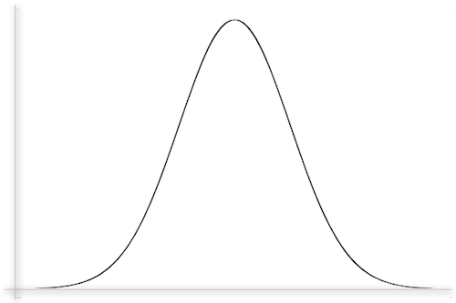
“Optimal Arousal”
Reaction
Fully engaged
Somewhat entertained
Bored or
Anxious
None………………Moderate………....Extreme
Level of Perceived Challenge

Slide 9
The role of goals
Motivation, self-regulation
Intrinsic vs. extrinsic
Task/mastery vs. ego/performance
Proximal; specific; meaningful; measurable
Flexible
Encourage, not deter

Slide 10
PROCESS GOALS
OUTCOME GOALS
Some characteristics of ‘short term’
Apply to each day, session, segment
Replace often
Provide frequent, ongoing feedback
Generally intrinsic, personal
Response: Inspiration, self-efficacy
Some characteristics of ‘long term’
Apply to longer periods of time or other measures
Usually retain until met; more likely to revise time period than goal
Provides infrequent (although potentially immensely rewarding) feedback
May be extrinsic, external
Response: “Now what?”
The key to effective results from either is ongoing use in a productive, positive way

Slide 11
Which type?* *(there may be more than one correct response)
Standing on your left leg, put your right sock on
Walk across Mississippi
Find your keys
Drive the Natchez Trace
Buy a bathing suit
Swim the English Channel

Slide 12
Activities
Sponge Tag
Instant Replay
Gotcha
Clap Trap

